Slide 1
Context-Aware Visual Compatibility Prediction (Paper)
Praguna Manvi, Vivek Talwar, Ankita Maity

Slide 2
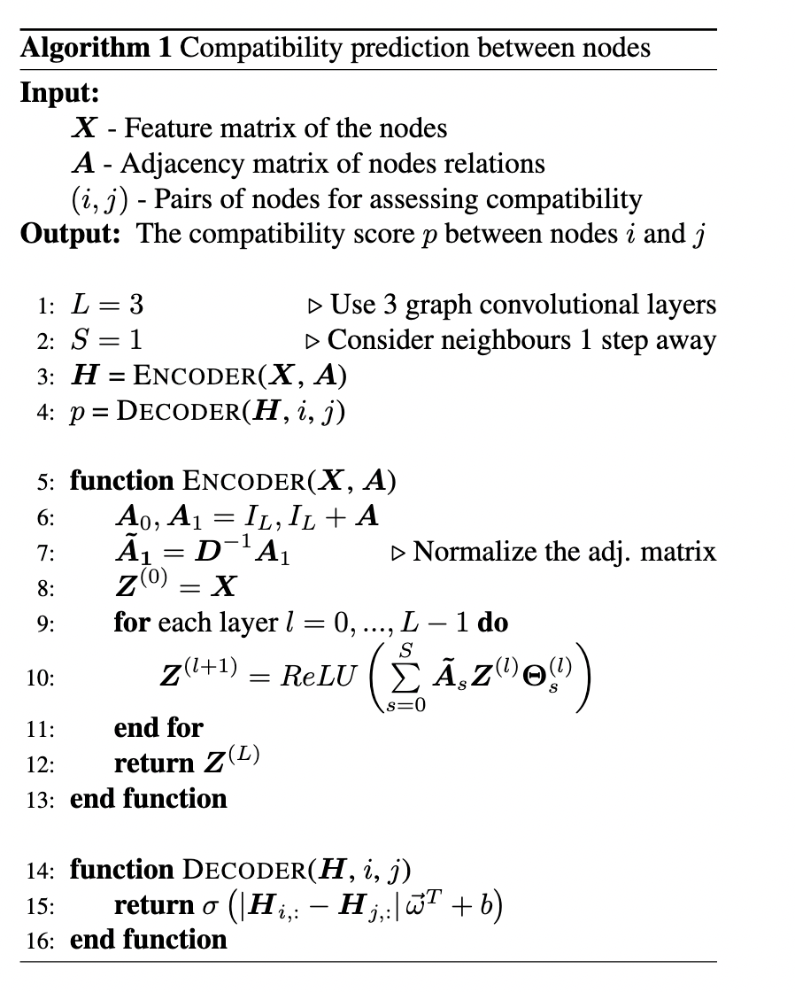
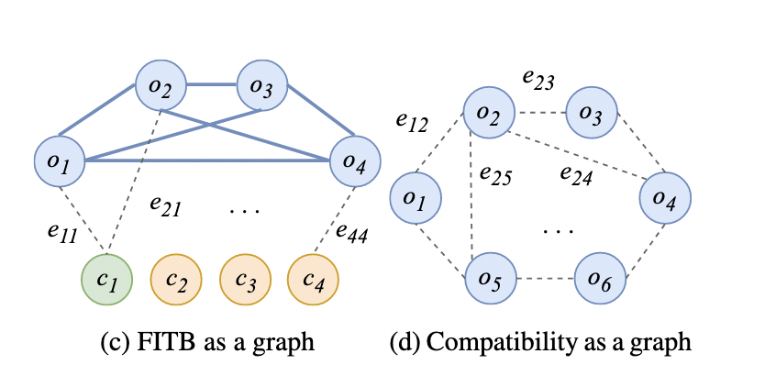
Approach

Slide 3
Why is this approach better
Contextual information is considered
Compatibility than similarity
Generalizes well on testset
Extendable approach to similar problems. (i.e main product detection etc)

Slide 4
Previous Results and Ideas for the Upcoming weeks
70% accuracy on polyvore dataset (partial training data) from code available online
Achieve SOTA results on polyvore dataset which is promised in the paper.
Build a multi-modal recommendation model, taking contextual textual data as well.
Experiments in Transductive setting.
Apply this on kaggle time series problem (i.e predict next 7 day purchases of the user)
Current model
Correct for accuracy
Textual context
Temporal context
Demo
Spatial context
Sota Results
Multimodal
Spatio-temporal (kaggle contest like)
( Will be slightly updated based on interesting approaches / constraints seen in the future)

Slide 5
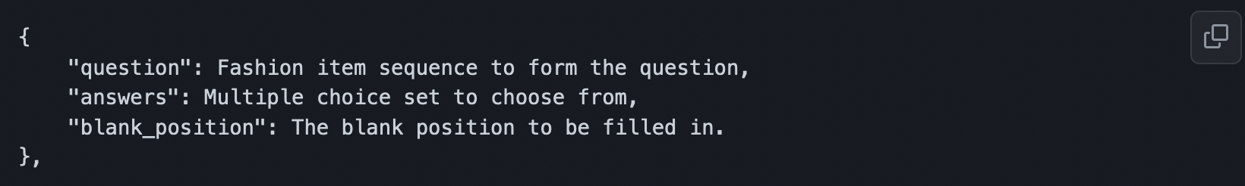
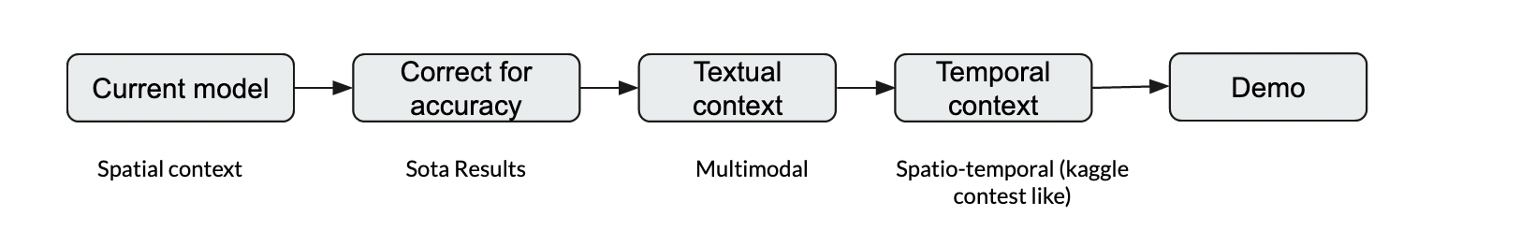
Current Results and Ideas for the Final Week
~90% accuracy on polyvore dataset, FITB task (full training data).
Learning involved : self-supervised embedding learning + negative example sampling + 4000 epochs
Build a multi-modal recommendation model, taking contextual textual data as well.
Embedding Generation spatio-temporally.
Apply this on kaggle time series problem + demo
Experiments on embedding generation for user-items dataset.

Slide 6
Approach for the Final Submission : (Will almost be the same)
Modelling Next 7 day purchase problem into FITB :
{
“question” : article id sequence for a customer-id ( previous purchase sequence)
“answers” : multiple choice of article id sequences
“blank_position” : fill for next day recursively asking the same question above
}
Train:
Learn the embeddings (image + user info (FCG))
Learn attention for previous purchases (in the aggregation layer)
Test :
Finally perform an edges prediction task, with the available answers (embeddings generated again using user context + image) with the aggregated embedding

Slide 7
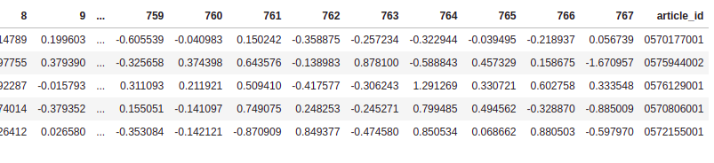
Embeddings Example (Generated using Swin Transformer)

Slide 8
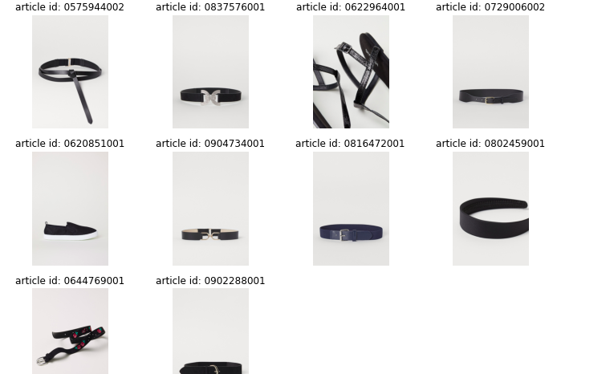
Nearest neighbor(Items closer visually to each other)

Slide 9
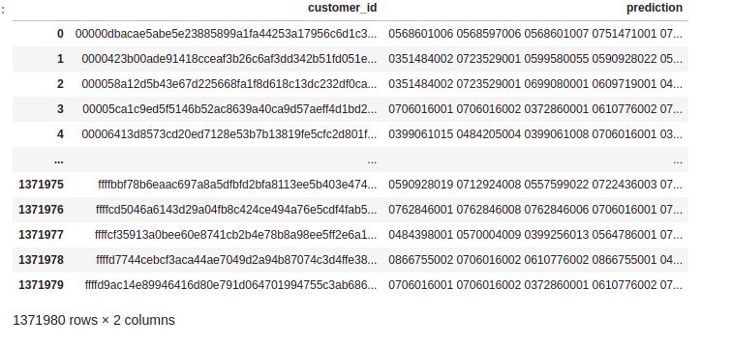
Collaborative Filtering with recommendation from the user

Slide 10
Future exploration
Spatio-Temporal GCN
Graph Attention Network
Neural Collaborative Filtering

Slide 11
References
Codebase : https://github.com/praguna/visual-compatibility-tdl/tree/main
Referred CodeBase: https://github.com/gcucurull/visual-compatibility/tree/master
Paper: https://arxiv.org/pdf/1902.03646.pdf
Kaggle competition: https://www.kaggle.com/c/h-and-m-personalized-fashion-recommendations/data

